Slide 1

Multilingual Language Translators Using Deep Learning
Exploring how artificial intelligence breaks down language barriers and connects the world through advanced neural networks.

Slide 2
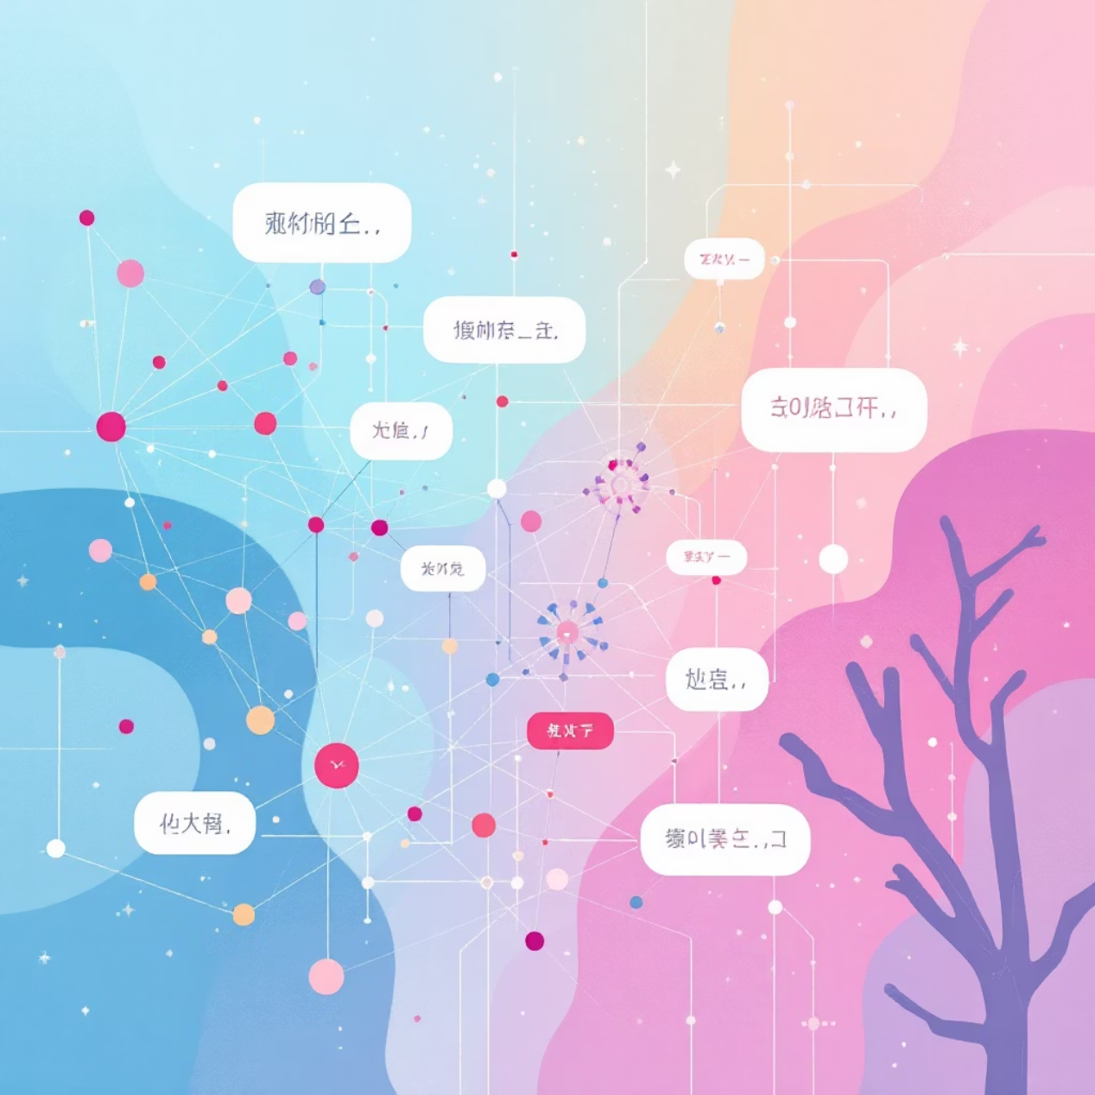

What is a Multilingual Language Translator?
A multilingual language translator is an intelligent system that automatically converts text or speech between multiple languages using deep learning algorithms.
Unlike traditional rule-based systems, these translators leverage neural networks to understand context, grammar, idioms, and cultural nuances — going far beyond simple word-for-word substitution.
Modern systems support anywhere from dozens to over a thousand languages, effectively breaking down communication barriers and enabling seamless global interaction.

Slide 3










Core Deep Learning Architecture
Encoder-Decoder with Attention Mechanism
Encoder
Attention
Decoder
Processes the input language sequence and converts it into a rich, meaningful representation using Transformer layers that capture semantic relationships.
The attention mechanism (like Luong attention) allows the model to dynamically focus on relevant parts of the input during each translation step, dramatically improving accuracy.
Generates the translated output sequence word-by-word, using techniques like scheduled sampling and beam search to optimize prediction quality and fluency.

Slide 4

Recent Breakthroughs & Unprecedented Scale
Google's Multilingual Transformers
SeamlessM4T Unified Model
Self-Supervised Learning
Meta's breakthrough model unifies speech-to-speech, speech-to-text, and text-to-text translation for 100+ languages in a single architecture, eliminating the need for separate specialized systems.
These advanced systems leverage self-supervised learning techniques on vast amounts of unlabeled data, enabling effective translation even for rare and low-resource language pairs.
Trained on massive parallel and monolingual datasets, these models now translate over 1,000 languages, including low-resource and endangered languages previously inaccessible to translation technology.

Slide 5




Real-World Impact & Future Directions
Global Communication
Cloud Integration
Enables real-time speech translation for international diplomacy, cross-border healthcare consultations, multilingual education, and seamless global business operations.
Cloud APIs like Google Translate API integrate advanced speech recognition and synthesis, delivering seamless voice translation experiences across devices and platforms.
Ongoing Research
Current research focuses on improving translation safety, reducing algorithmic bias, expanding language coverage to include indigenous languages, and preserving cultural context.
Deep learning continues to push the boundaries of multilingual communication, making our world more connected, accessible, and inclusive — one translation at a time.

Slide 6



Conclusion: Worlds with AI
Revolutionizing Communication
Unlocking Global Connectivity
A Future of Seamless Interaction
Deep learning, particularly transformer architectures, has fundamentally reshaped how we translate, moving beyond literal translations to contextual understanding.
These advanced systems enable real-time, multilingual interactions, fostering unprecedented levels of global understanding and collaboration across all sectors.
Ongoing research aims to further enhance accuracy, expand language coverage, and address ethical considerations, paving the way for a truly interconnected world.
As deep learning continues to evolve, multilingual language translators will play an increasingly vital role in making our world more accessible and inclusive for everyone.

